Slide 1
Promotions Management Landing page - Requirement

Slide 2
Landing page idea
This view attempts to:
Give a central place to view all promos that have been created in the system
Gives high level view of the current status of the promotions

Slide 3
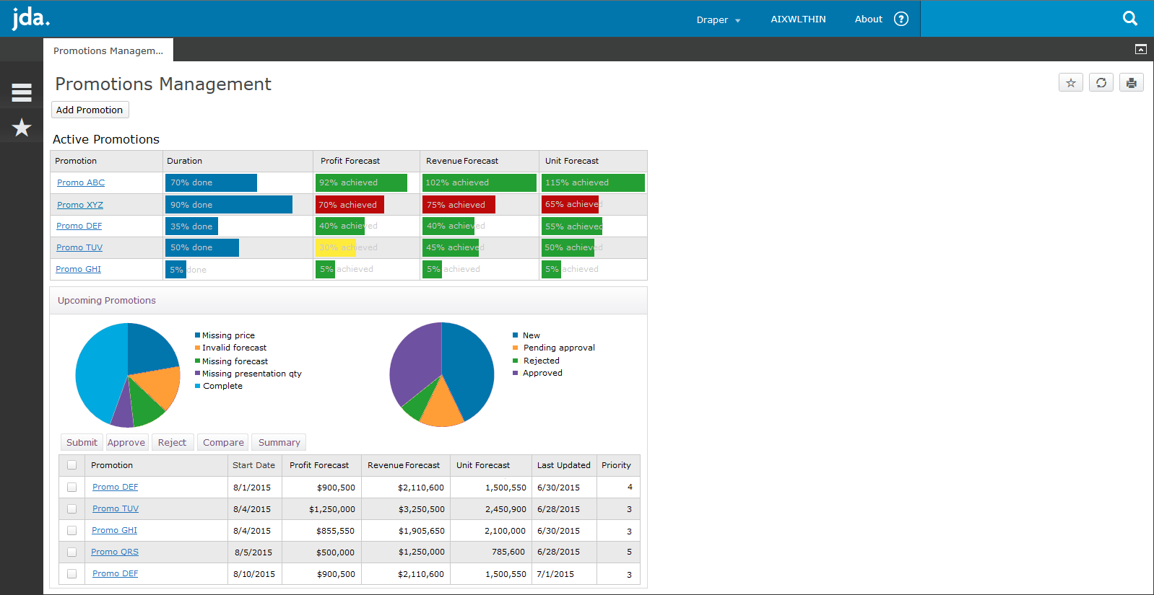
Landing page
Add new promo
View active promotions
Select a pie segment to filter the grid
Select multiple and set status
Select multiple and compare or summarize
View/Edit promotion

Slide 4
Landing page
Active Promotions:
Elapsed duration
At-a-glance progress toward Profit, Revenue and Unit sales forecasts
Select a row to view additional information (next slide)
Upcoming Promotions:
List of all promotions added but not active
Pie charts show exceptions and status breakdown (filter grid by selecting a pie
Select a promotion to open the workbench
We could also add a link to the import process page

Slide 5
Promotions Management Landing page - Requirement

